Slide 1
Time for a break
That’s the end of the quiz

Slide 2
Answers

Slide 3
Answer 1
10% of Americans think it is acceptable to start drinking at what time.
10 AM or earlier
noon or earlier
2pm or later
6pm or later

Slide 4
Answer 1
10% of Americans think it is acceptable to start drinking at what time.
10 AM or earlier
noon or earlier
2pm or later
6pm or later

Slide 5
Answer 2
Pteronophobia is the fear of what;
Flying lizards
Canada
Feathers
The dark

Slide 6
Answer 2
Pteronophobia is the fear of what;
Flying lizards
Canada
Feathers
The dark

Slide 7
Answer 3
More than what percentage of the world's population consumes caffeine on a daily basis.
30%
50%
70%
90%

Slide 8
Answer 3
More than what percentage of the world's population consumes caffeine on a daily basis.
30%
50%
70%
90%

Slide 9
Answer 4
New Zealand has the ability to block certain baby names if they’re considered offensive. Which one of these is a rejected name?
Violence
Number 16 Bus Shelter
Twins called Fish and Chips
Twins called Benson and Hedges

Slide 10
Answer 4
New Zealand has the ability to block certain baby names if they’re considered offensive. Which one of these is a rejected name?
Violence
Number 16 Bus Shelter
Twins called Fish and Chips
Twins called Benson and Hedges

Slide 11
Answer 5
In 1995, Tuvalu was assigned the domain code .tv. Tuvalu now earns about what fraction of its annual gross national income by licensing .tv to tech companies.
1/24th
1/12th
1/9th
1/4th

Slide 12
Answer 5
In 1995, Tuvalu was assigned the domain code .tv. Tuvalu now earns about what fraction of its annual gross national income by licensing .tv to tech companies.
1/24th
1/12th
1/9th
1/4th

Slide 13
Answer 6
A Russian book on etiquette from 1889 suggested that women should avoid what?
Shouting
Talking to your neighbours husband
Unpleasant language
Puns

Slide 14
Answer 6
A Russian book on etiquette from 1889 suggested that women should avoid what?
Shouting
Talking to your neighbours husband
Unpleasant language
Puns (Quote on next slide)

Slide 15
Answer 6
Quote:
“One or two puns might even seem entertaining, but three puns in a row from a woman’s lips would definitely be an unpleasant thing.”

Slide 16
Answer 7
Which primates have the largest average size of penises.
Gorilla
Human
Orangutan
Chimpanzee

Slide 17
Answer 7
Which primates have the largest average size of penises.
Gorilla
Human
Orangutan
Chimpanzee

Slide 18
Answer 8
Which of these is an acronym
Wtf
Fyi
Lol
Lmfao

Slide 19
Answer 8
Which of these is an acronym
Wtf
Fyi
Lol
Lmfao
The others are initialisims

Slide 20
Answer 9
If you received x dollars for every year that the universe has existed, you would have approximately as much money as Jeff Bezos.
$1
$10
$100
$1000

Slide 21
Answer 9
If you received x dollars for every year that the universe has existed, you would have approximately as much money as Jeff Bezos.
$1
$10
$100
$1000

Slide 22
Answer 10
The first sport to resume after the UK’s Coronavirus lockdown was eased was;
competitive pigeon racing
golf
tennis
snooker

Slide 23
Answer 10
The first sport to resume after the UK’s Coronavirus lockdown was eased was;
competitive pigeon racing
golf
tennis
snooker

Slide 24
Answer 11
True or False?
In Texas it is illegal to change the weather

Slide 25
Answer 11
True or False?
In Texas it is illegal to change the weather.
TRUE

Slide 26
Answer 12
True or False?
In the USA it is illegal for more and 2 people to gather in public wearing masks.

Slide 27
Answer 12
True or False?
In the USA it is illegal for more and 2 people to gather in public wearing masks..
FALSE
But it is illegal in New York state

Slide 28
Answer 13
True or False?
There is an ancient Egyptian frieze in The Temple of Seti that appears to show a helicopter, an aeroplane and a submarine.

Slide 29
Answer 13
True or False?
There is an ancient Egyptian frieze in The Temple of Seti that appears to show a helicopter, an aeroplane and a submarine.
TRUE

Slide 30
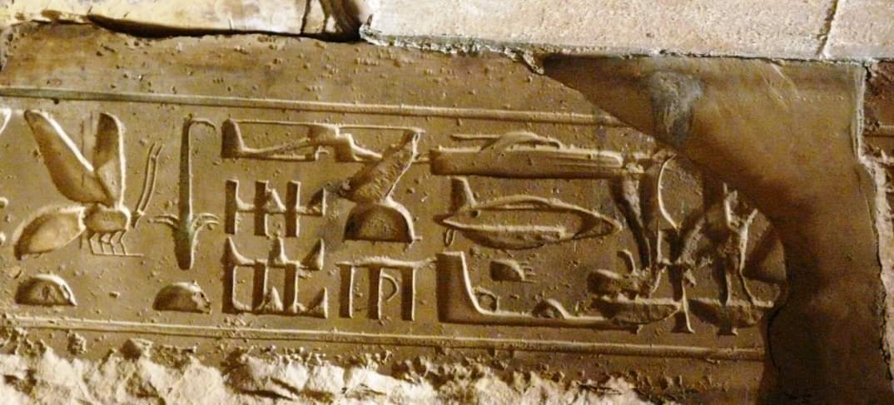
Answer 13

Slide 31
Answer 14
True or False?
The average person walks past 5 murderers in their life.

Slide 32
Answer 14
True or False?
The average person walks past 5 murderers in their life.
False
The average person walks past 11 murderers in their life.

Slide 33
Answer 15
True or False?
Humans glow in the dark

Slide 34
Answer 15
True or False?
Humans glow in the dark
TRUE
Ultra-sensitive cameras reveal that our bodies emit tiny amounts of light that are too weak for the human eye to detect

Slide 35
Question 16
True or False?
The American state of New Hampshire has just legalised flying cars

Slide 36
Question 16
True or False?
The American state of New Hampshire has just legalised flying cars.
TRUE
As of August 2020

Slide 37
Answer 17
True or False?
The Swedish word GÖKOTTA means to wake up early in the morning in order to go outside and hear the first birds sing

Slide 38
Answer 17
True or False?
The Swedish word GÖKOTTA means to wake up early in the morning in order to go outside and hear the first birds sing
TRUE

Slide 39
Answer 18
True or False?
Among the Yoruba-speaking population of Nigeria, “Man United” is slang for “idiot”.

Slide 40
Answer 18
True or False?
Among the Yoruba-speaking population of Nigeria, “Man United” is slang for “idiot”.
FALSE
Actually “Dundee United” is slang for “idiot”.

Slide 41
Answer 19
True or False?
Every Dutch police car is equipped with a teddy bear to give children that are scared

Slide 42
Answer 19
True or False?
Every Dutch police car is equipped with a teddy bear to give children that are scared
TRUE

Slide 43
Answer 20
True or False?
It is illegal to own a rabbit in Queensland, Australia unless you can prove you are a practicing magician.

Slide 44
Answer 20
True or False?
It is illegal to own a rabbit in Queensland, Australia unless you can prove you are a practicing magician.
TRUE

Slide 45
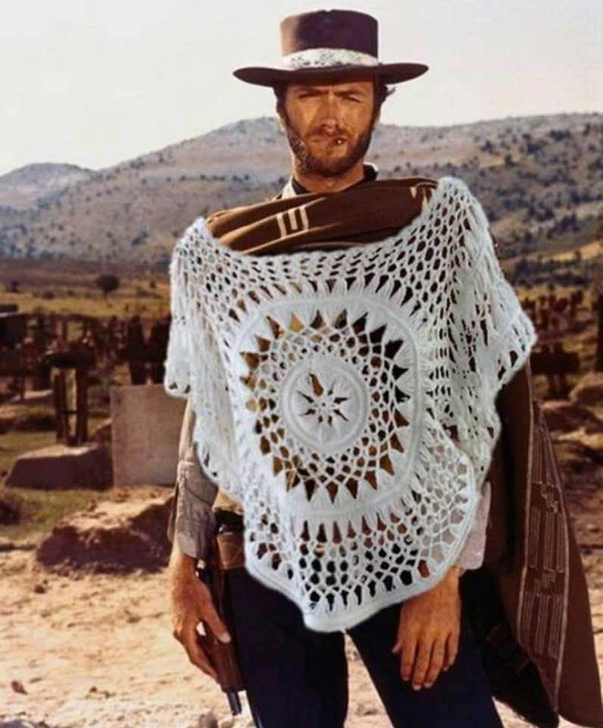
Question 21
Name the film
(say what you see)

Slide 46
Question 21
Name the film
A Fist Full of Doilies

Slide 47
Answer 22
Monks in the Khun Han district of Thailand were frustrated with littering in their district, so they did what?

Slide 48
Answer 22
Monks in the Khun Han district of Thailand were frustrated with littering in their district, so they built a temple entirely made from discarded beer bottles.

Slide 49

Answer 22
Monks in the Khun Han district of Thailand were frustrated with littering in their district, so they built a temple entirely made from discarded beer bottles.

Slide 50
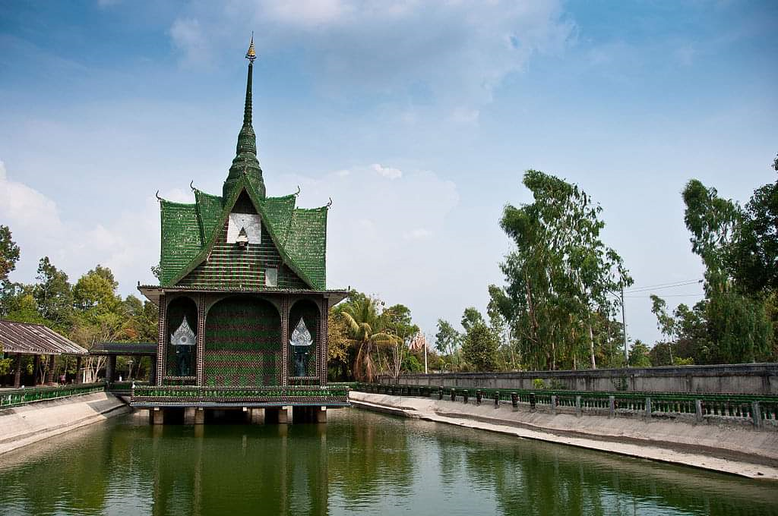
Answer 22
Monks in the Khun Han district of Thailand were frustrated with littering in their district, so they built a temple entirely made from discarded beer bottles.

Slide 51
Answer 23
Lloyds Bank Coprolite was left behind by the Vikings. It was found in York where a branch of Lloyds Bank now stands. What is it?

Slide 52
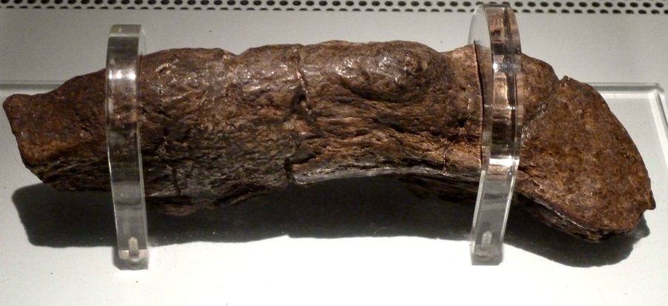
Answer 23
This fossilised Viking poo is called the Lloyds Bank Coprolite. The depositor had a diet of bread and meat and had intestinal parasites.

Slide 53
Answer 24
Dr Seuss' publisher bet $50 that him he could not write a book using only 50 words. Did he win the bet?

Slide 54
Answer 24
Dr Seuss' publisher bet $50 that him he could not write a book using only 50 words. Did he win the bet?
Seuss won the bet by writing Green Eggs and Ham.

Slide 55
Answer 25
HOFSTADTER'S LAW states that "a task always takes longer than you expect, even when you take into account …“ What?

Slide 56
Answer 25
HOFSTADTER'S LAW states that "a task always takes longer than you expect, even when you take into account HOFSTADTER'S LAW“

Slide 57
Answer 26
What music Album was so popular in Poland that the nation exhausted its entire supply of foreign currency buying?

Slide 58
Answer 26
What music Album was so popular in Poland that the nation exhausted its entire supply of foreign currency buying?
ABBA: The Album

Slide 59
Answer 27
What does it mean to be stereoblind?

Slide 60
Answer 27
What does it mean to be stereoblind?
Lack of depth perception
In 2012, a man born stereoblind had the condition completely erased when he went to see a 3D version of Martin Scorsese’s “‘Hugo”.

Slide 61
Answer 28
The Icelandic word ‘vasa’ means pocket.
What famous 1980’s product was given the Icelandic name ‘vasadiskó’.

Slide 62
Answer 28
The Icelandic word ‘vasa’ means pocket.
What famous 1980’s product was given the Icelandic name ‘vasadiskó’.
The literal name pocket disco describes the
Walkman

Slide 63
Answer 29
Name something often found in the bottom of bird cages _ _ IT

Slide 64
Answer 29
Name something often found in the bottom of bird cages _ _ IT
Grit

Slide 65
Answer 30
What's red and smells and is often picked in the garden _ OSE

Slide 66
Answer 30
What's red and smells and is often picked in the garden _ OSE
NOSE

Slide 67
Answer 31
True False,
Before taking office in Kentucky, all politicians must swear that they have never been in a gun fight

Slide 68
Answer 31
True False,
Before taking office in Kentucky, all politicians must swear that they have never been in a gun fight
FALSE
But they must swear that they have never challenged anyone to a duel

Slide 69
Answer 32
What part of a car, has been engineered using psychoacoustics to sound much more robust than it actually is.
Engine
Breaks
Door
Trunk (the boot in England)

Slide 70
Answer 32
What part of a car, has been engineered using psychoacoustics to sound much more robust than it actually is.
Engine
Breaks
Door - It is supposed to made “a solid Thunk sound”!
Trunk (the boot in England)

Slide 71
Answer 33
What is the most popular “trade name” surname across Europe.

Slide 72
Answer 33
What is the most popular “trade name” surname across Europe.
As in the UK, it is Smith

Slide 73
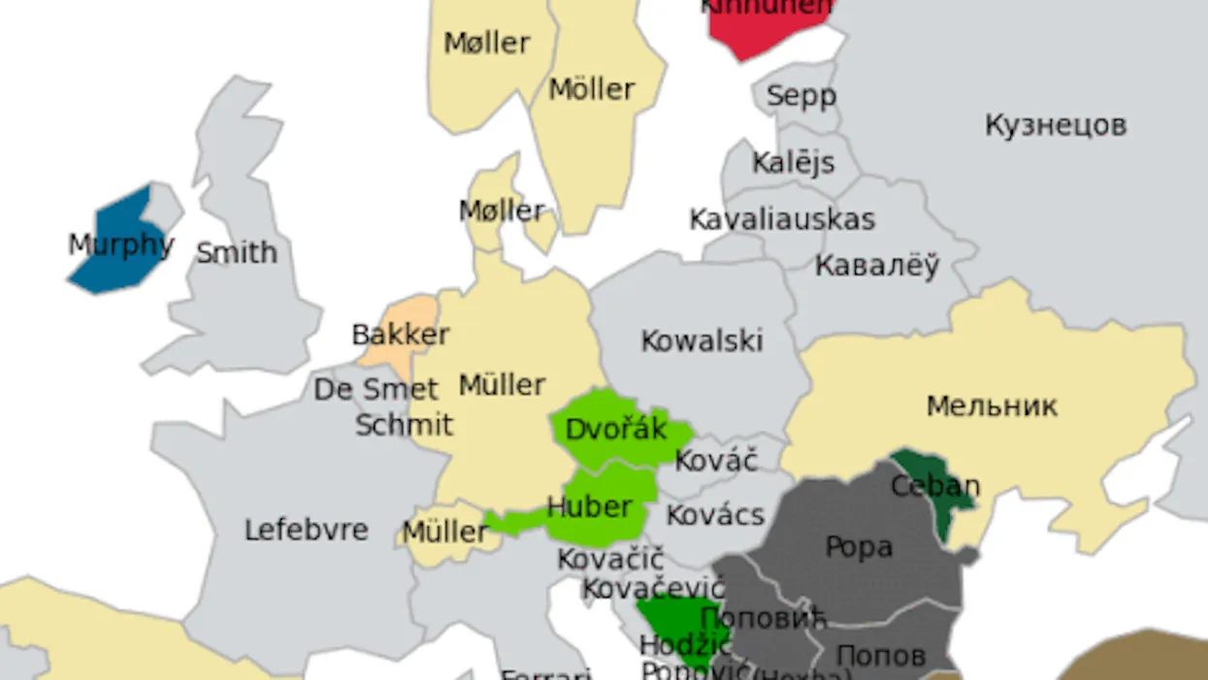
Answer 33
What is the most popular “trade name” surname across Europe.
As in the UK, it is Smith

Slide 74
Answer 34
How many species of shark that can walk across land?
None
One
Five
Nine

Slide 75
Answer 34
How many species of shark that can walk across land?
None
One
Five
Nine

Slide 76
Answer 35
True or False
People who reflexively sneeze if a bright light is shone in their eyes have ACHOO syndrome.

Slide 77
Answer 35
True or False
People who reflexively sneeze if a bright light is shone in their eyes have ACHOO syndrome. TRUE
Autosomal Compulsive Helio-ophthalmic Outbursts syndrome

Slide 78
Answer 36
The word ‘good-bye’ comes from the 16th-century word ‘godbwye’, which literally means what?

Slide 79
Answer 36
The word ‘good-bye’ comes from the 16th-century word ‘godbwye’, which literally means what?
God be with ye

Slide 80
ANSWER 37
In ‘The Art of Farting’ (1751), Pierre-Thomas Hurtault gave a classification of farts that included 3 of the following. Which one is false
Silent but smelly
Soft and sudden
Bourgeois women
Geographers

Slide 81
ANSWER 37
In ‘The Art of Farting’ (1751), Pierre-Thomas Hurtault gave a classification of farts that included 3 of the following. Which one is false
Silent but smelly
Soft and sudden
Bourgeois women
Geographers
More on next slide

Slide 82
ANSWER 37
Others included;
household
fencing master
cuckolds
tasting of plums
provincial, and
‘less falsified than those of Paris, where all is refined’.

Slide 83
Answer 38
True or false,
The Beatles wanted to make a Lord of the Rings film with John Lennon as Golum.

Slide 84
Answer 38
True or false,
The Beatles wanted to make a Lord of the Rings film with John Lennon as Golum.
TRUE

Slide 85
ANSWER 39
When a tattoo is laser-removed, what happens to the ink?

Slide 86
ANSWER 39
When a tattoo is laser-removed, it is broken down so that white blood cells are able to remove it, and it is then passed as excrement.

Slide 87
Answer 40
How long was the world’s longest recorded fart?
(Nearest answer wins)

Slide 88
Answer 40
How long was the world’s longest recorded fart?
2 minutes and 42 seconds

Slide 89
Thank you

